Slide 1
“Carpe diem et patientia” (Seize the day and endure) Nehemiah 2:1-20

Slide 2
“Carpe diem et patientia” (Seize the day and endure) Nehemiah 2:1-20
Nehemiah learned to wait on God

Slide 3
“Carpe diem et patientia” (Seize the day and endure) Nehemiah 2:1-20
Nehemiah learned to wait on God
Whilst waiting, he prayed

Slide 4
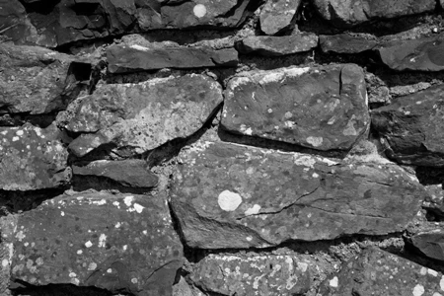
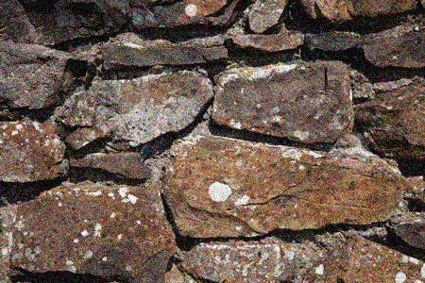
“Carpe diem et patientia” (Seize the day and endure) Nehemiah 2:1-20
Nehemiah learned to wait on God
Whilst waiting, he prayed
“Pray without ceasing” 1 Thess 5:17

Slide 5
“Carpe diem et patientia” (Seize the day and endure) Nehemiah 2:1-20
Nehemiah learned to wait on God
Whilst waiting, he prayed
Whilst waiting, he developed patience

Slide 6
“Carpe diem et patientia” (Seize the day and endure) Nehemiah 2:1-20
Nehemiah learned to wait on God
Whilst waiting, he prayed
Whilst waiting, he developed patience
Whilst waiting, he planned

Slide 7
“Carpe diem et patientia” (Seize the day and endure) Nehemiah 2:1-20
Nehemiah learned to wait on God
Whilst waiting, he prayed
Whilst waiting, he developed patience
Whilst waiting, he planned
He gave the king a time

Slide 8
“Carpe diem et patientia” (Seize the day and endure) Nehemiah 2:1-20
Nehemiah learned to wait on God
Whilst waiting, he prayed
Whilst waiting, he developed patience
Whilst waiting, he planned
He gave the king a time
He made specific request for safe passage

Slide 9
“Carpe diem et patientia” (Seize the day and endure) Nehemiah 2:1-20
Nehemiah learned to wait on God
Whilst waiting, he prayed
Whilst waiting, he developed patience
Whilst waiting, he planned
He gave the king a time
He made specific request for safe passage
He asked for requisition orders

Slide 10
“Carpe diem et patientia” (Seize the day and endure) Nehemiah 2:1-20
Nehemiah learned to wait on God
Whilst waiting, he prayed
Whilst waiting, he developed patience
Whilst waiting, he planned
Prayer and planning are not incompatible!

Slide 11
“Carpe diem et patientia” (Seize the day and endure) Nehemiah 2:1-20
Nehemiah learned to wait on God
Nehemiah learned to work with people

Slide 12
“Carpe diem et patientia” (Seize the day and endure) Nehemiah 2:1-20
Nehemiah learned to wait on God
Nehemiah learned to work with people
A pagan king

Slide 13
“Carpe diem et patientia” (Seize the day and endure) Nehemiah 2:1-20
Nehemiah learned to wait on God
Nehemiah learned to work with people
A pagan king
The king sent this reply:…“The letter you sent us has been read and translated in my presence. I issued an order and a search was made, and it was found that this city has a long history of revolt against kings and has been a place of rebellion and sedition. Jerusalem has had powerful kings ruling over the whole of Trans-Euphrates, and taxes, tribute and duty were paid to them. Now issue an order to these men to stop work, so that this city will not be rebuilt until I so order” (Ezra 4:17, 18-21).

Slide 14
“Carpe diem et patientia” (Seize the day and endure) Nehemiah 2:1-20
Nehemiah learned to wait on God
Nehemiah learned to work with people
A pagan king
Nehemiah prayed

Slide 15
“Carpe diem et patientia” (Seize the day and endure) Nehemiah 2:1-20
Nehemiah learned to wait on God
Nehemiah learned to work with people
A pagan king
Nehemiah prayed
His service was exemplary

Slide 16
“Carpe diem et patientia” (Seize the day and endure) Nehemiah 2:1-20
Nehemiah learned to wait on God
Nehemiah learned to work with people
A pagan king
Nehemiah prayed
His service was exemplary
He employed great tact

Slide 17
“Carpe diem et patientia” (Seize the day and endure) Nehemiah 2:1-20
Nehemiah learned to wait on God
Nehemiah learned to work with people
A pagan king
Demoralized Jews in Jerusalem

Slide 18
“Carpe diem et patientia” (Seize the day and endure) Nehemiah 2:1-20
Nehemiah learned to wait on God
Nehemiah learned to work with people
A pagan king
Demoralized Jews in Jerusalem
Nehemiah understood the psychology of a beaten people

Slide 19
“Carpe diem et patientia” (Seize the day and endure) Nehemiah 2:1-20
Nehemiah learned to wait on God
Nehemiah learned to work with people
A pagan king
Demoralized Jews in Jerusalem
Nehemiah understood the psychology of a beaten people
Nehemiah identified himself with them

Slide 20
“Carpe diem et patientia” (Seize the day and endure) Nehemiah 2:1-20
Nehemiah learned to wait on God
Nehemiah learned to work with people
A pagan king
Demoralized Jews in Jerusalem
Pagan enemies who opposed the work

Slide 21
“Carpe diem et patientia” (Seize the day and endure) Nehemiah 2:1-20
Nehemiah learned to wait on God
Nehemiah learned to work with people
A pagan king
Demoralized Jews in Jerusalem
Pagan enemies who opposed the work
Nehemiah demonstrated wisdom and courage

Slide 22
“Carpe diem et patientia” (Seize the day and endure) Nehemiah 2:1-20
Nehemiah learned to wait on God
Nehemiah learned to work with people
Nehemiah learned to wrestle with problems

Slide 23
“Carpe diem et patientia” (Seize the day and endure) Nehemiah 2:1-20
Nehemiah learned to wait on God
Nehemiah learned to work with people
Nehemiah learned to wrestle with problems
I had not told anyone what my God had put in my heart to do for Jerusalem… By night I went out through the Valley Gate toward the Jackal Well and the Dung Gate, examining the walls of Jerusalem, which had been broken down, and its gates, which had been destroyed by fire. Then I moved on… but there was not enough room for my mount to get through; so I went up the valley by night. Finally, I turned back and re-entered through the Valley Gate. The officials did not know where I had gone or what I was doing, because as yet I had said nothing to the Jews or the priests or nobles or officials or any others who would be doing the work. (Nehemiah 2:12b-16 NIV)

Slide 24
“Carpe diem et patientia” (Seize the day and endure) Nehemiah 2:1-20
Nehemiah learned to wait on God
Nehemiah learned to work with people
Nehemiah learned to wrestle with problems
Nehemiah faced reality head on

Slide 25
“Carpe diem et patientia” (Seize the day and endure) Nehemiah 2:1-20
Nehemiah learned to wait on God
Nehemiah learned to work with people
Nehemiah learned to wrestle with problems
Nehemiah faced reality head on
Nehemiah engaged in frank discussion
“You see the trouble we are in: Jerusalem lies in ruins, and its gates have been burned with fire. Come, let us rebuild the wall of Jerusalem, and we will no longer be in disgrace." (2:17-18)

Slide 26
“Carpe diem et patientia” (Seize the day and endure) Nehemiah 2:1-20
Nehemiah learned to wait on God
Nehemiah learned to work with people
Nehemiah learned to wrestle with problems
Lessons:
Use the “copycat” tool (See Dig Deeper ch. 14)

Slide 27
“Carpe diem et patientia” (Seize the day and endure) Nehemiah 2:1-20
Nehemiah learned to wait on God
Nehemiah learned to work with people
Nehemiah learned to wrestle with problems
Lessons:
Use the “copycat” tool (See Dig Deeper ch. 14)
Wait on God for his perfect time

Slide 28
“Carpe diem et patientia” (Seize the day and endure) Nehemiah 2:1-20
Nehemiah learned to wait on God
Nehemiah learned to work with people
Nehemiah learned to wrestle with problems
Lessons:
Use the “copycat” tool (See Dig Deeper ch. 14)
Wait on God for his perfect time
Seize the day

Slide 29
“Carpe diem et patientia” (Seize the day and endure) Nehemiah 2:1-20
Nehemiah learned to wait on God
Nehemiah learned to work with people
Nehemiah learned to wrestle with problems
Lessons:
Use the “copycat” tool (See Dig Deeper ch. 14)
Wait on God for his perfect time
Seize the day
Persevere despite the setbacks

